Slide 1



Data Visualization in R
Workshop Lead: Meghana Munipalle
Date: October 27, 2026

Slide 2

Scan the QR code to sign up
for our mailing list!
Notes:
The McGill initiative on Computational Medicine was formed in 2017 and aims to deliver inter-disciplinary research programs and empower the use of data in health research and health care delivery
Located at the Genome Center
They have a newsletter were you can subscribe to
more info on the web site

Slide 3
Goals
Better interpretability: transformations & faceting to make better comparisons
Better clarity: customize your aesthetics to communicate data insights more effectively
Better engagement: let people interact with your visualizations
Better storytelling: what’s the right plot type for your analysis?

Slide 4

Outline
Module 1: Brief Review of Basic Visualization in R
  Why use ggplot 2
  Structure of a ggplot2 command
Module 2: Advanced Customization and Data Transformation
  Data transformations and faceting
  Customizing ggplot2 plots
  Exercise 1
Module 3: Advanced Visualization Techniques
  Specialized plots
  Introduction to interactive and dynamic visualizations
  Exercise 2

Slide 5
Why Use ggplot2 Over Base R for Data Visualization?
With better aesthetic and higher efficiency
Feature | ggplot2 | Base R
Design Framework | Based on Grammar of Graphics, enabling layered construction | Procedural approach, harder to modify and extend
Customization | Themes and formatting (theme_*) for professional aesthetics | Requires manual adjustments using par() or axis()
Faceting | Built-in with facet_wrap() and facet_grid() | Requires manual layout setup
Syntax | Consistent and modular, easy to learn and maintain | Fragmented and less intuitive
Data Transformations | Directly supports scaling and slicing in plots | Preprocessing required before visualization
Multi-layered Plots | Allows layering of multiple plot types and elements | Complex to achieve with overlays
Interactivity | Seamless integration with interactive packages like plotly | Requires external packages with complex workflows

Slide 6
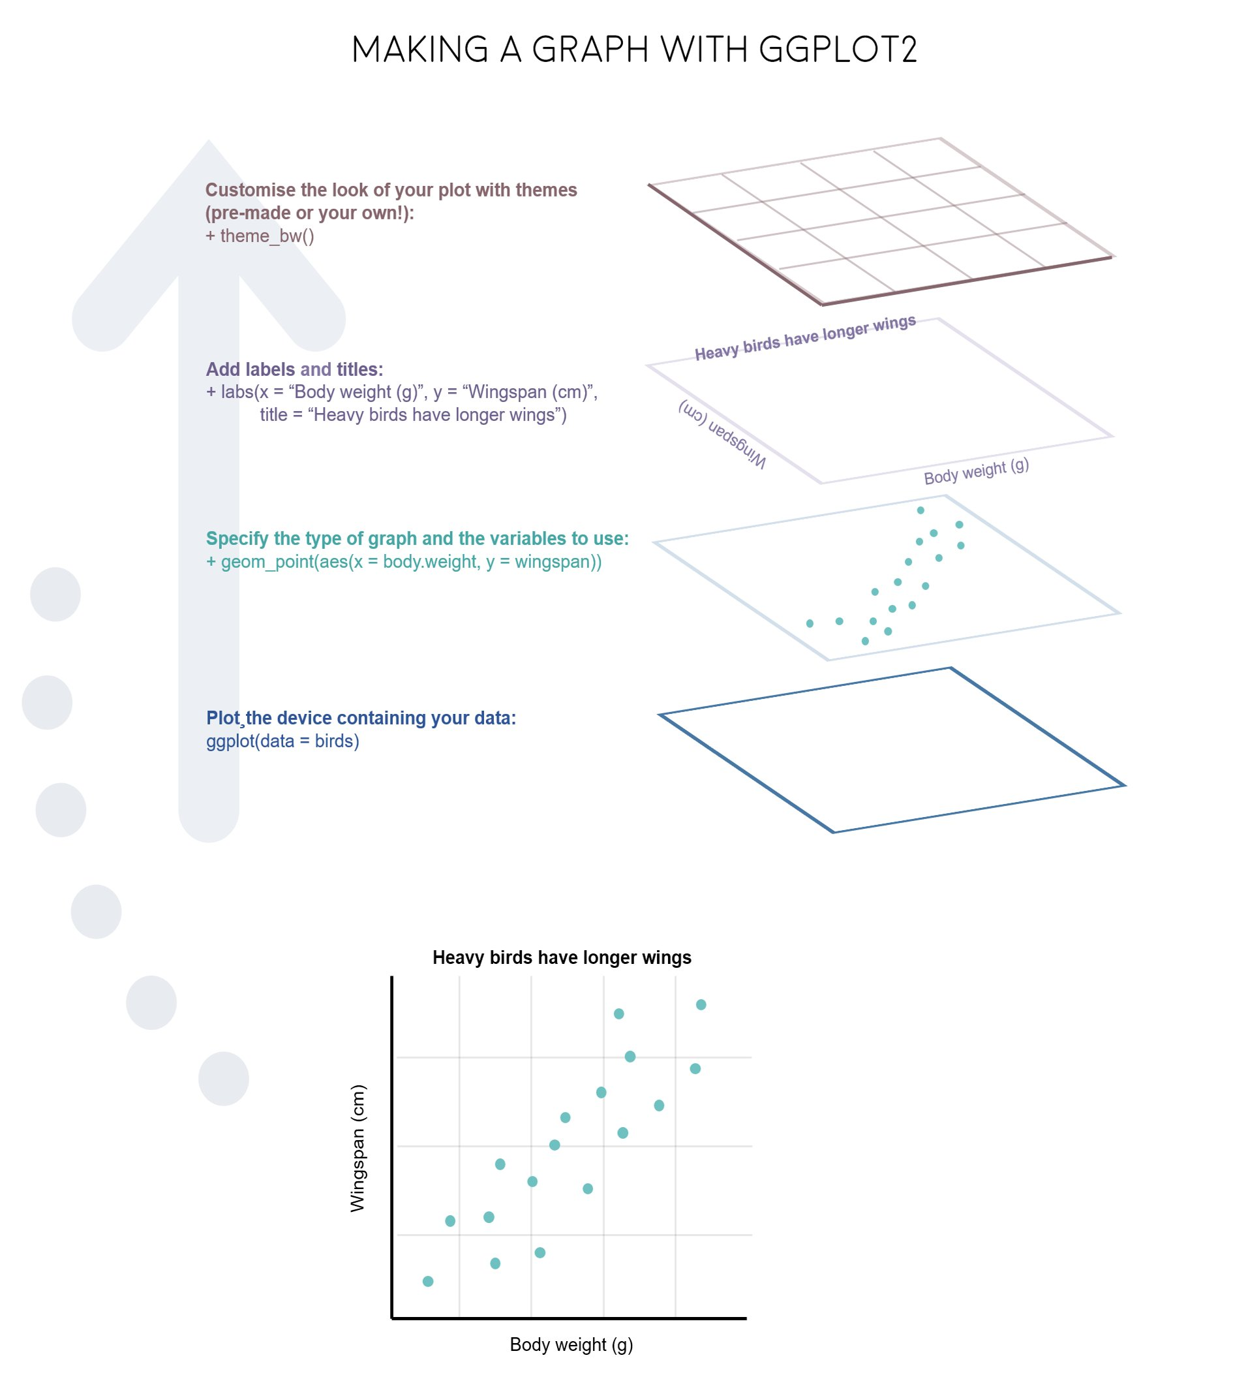
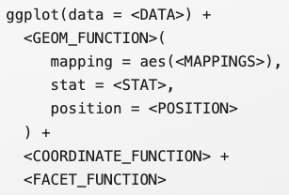
Overview of ggplot2
gg = “grammar of graphics”
Components in ggplot2:
  Data
  Aesthetic attribute (Aes)
  Geometric object (Geom)
  Stats
  Position
  Coord
  Facet
  Theme
  ……

Slide 7
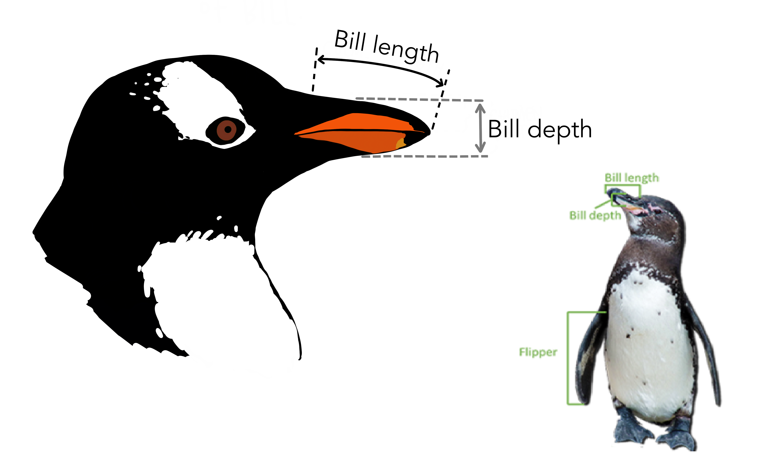
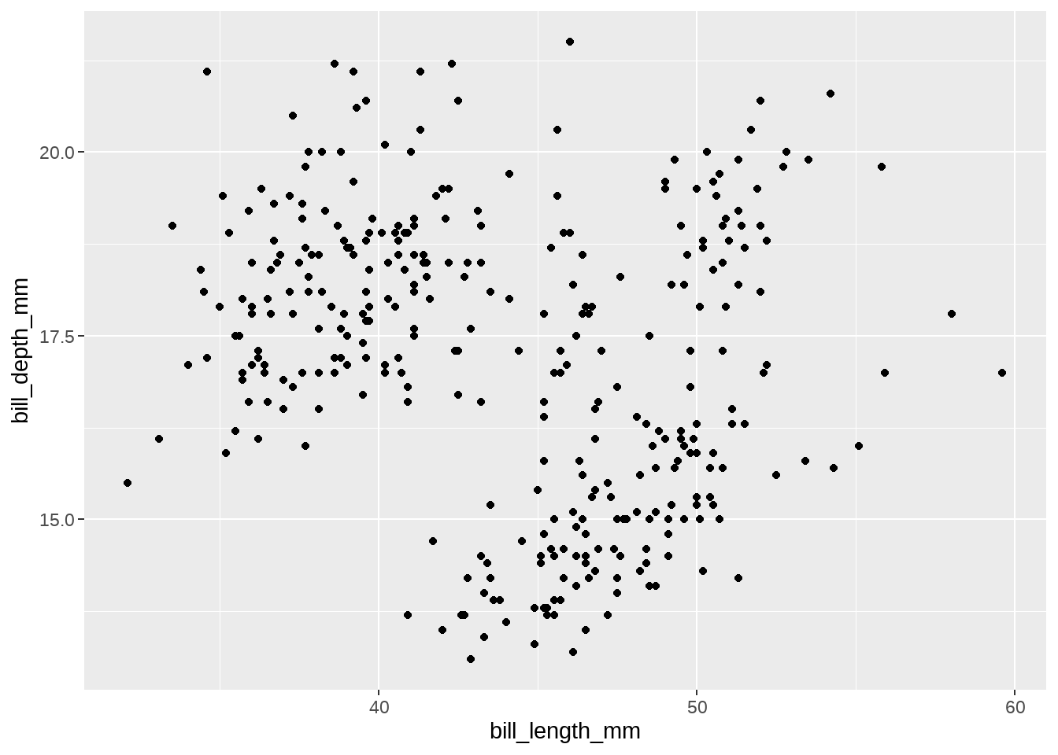
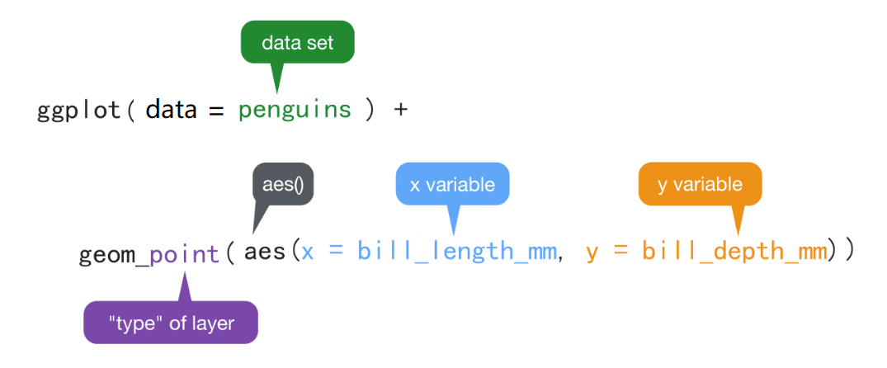
Structure of the ggplot2 command
What is the relationship between penguin bill length and bill depth?

Slide 8
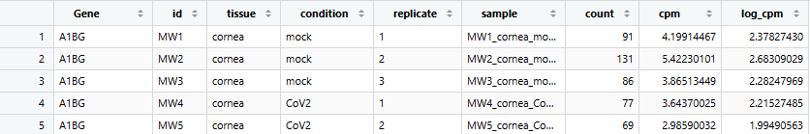
Dataset preparation
RNA-seq
387,216 observations
9 variables
  Country: a factor with 142 levels
  Continent: a factor with 5 levels
  Year: going from 1952 to 2007 in increments of 5 years
  Pop: population
  gdpPercap: GDP per capita
  lifeExp: life expectancy

Slide 9
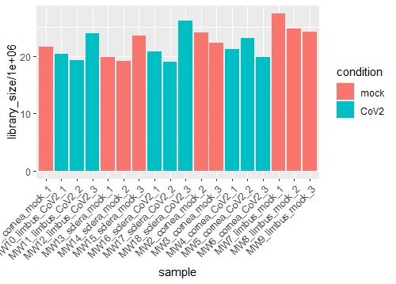
Bar plot
discrete variable
ggplot(samples, aes(x = sample, y = library_size / 1e6, fill = condition)) + geom_col() + theme(axis.text.x = element_text(angle = 45, hjust = 1))
Research Question:
Were all 18 samples sequenced to a similar depth?

Slide 10
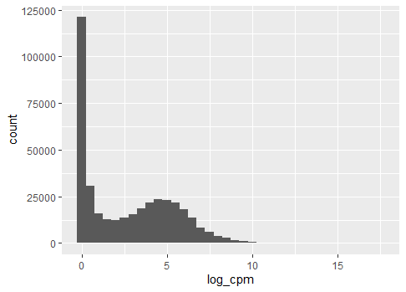
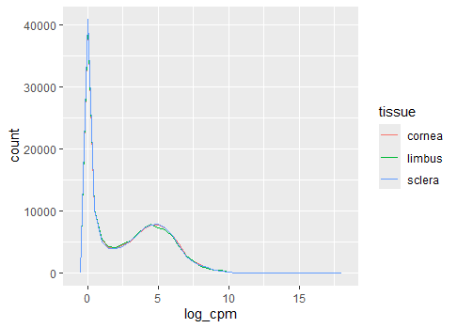
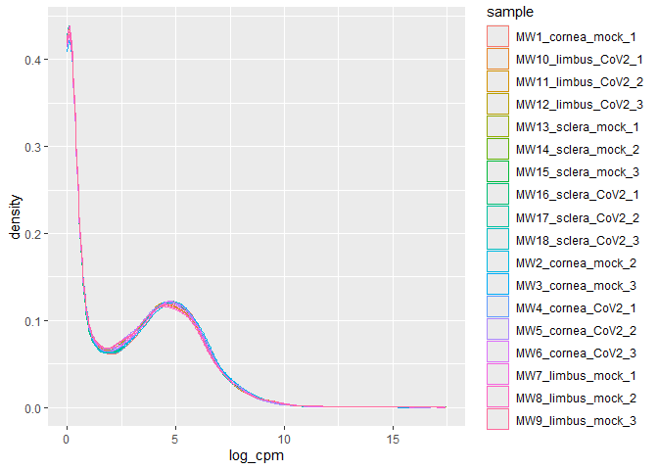
Histogram/ Frequency/ Density Plot
Choosing the right plot
To see raw counts and distribution shape -> Histogram
To compare multiple groups without overlap issues -> Frequency
To observe smoothed probability distributions and peaks -> Density
ggplot(expr, aes(x = log_cpm, colour = tissue)) + geom_freqpoly(binwidth = 0.5)
ggplot(expr, aes(x = log_cpm, colour = sample)) + geom_density()
ggplot(expr, aes(x = log_cpm)) + geom_histogram(binwidth = 0.5)
Do all samples have similar expression distributions, or does any sample look unusual?
What is the overall distribution of gene expression levels?
Compare the expression distributions across the three tissues.

Slide 11
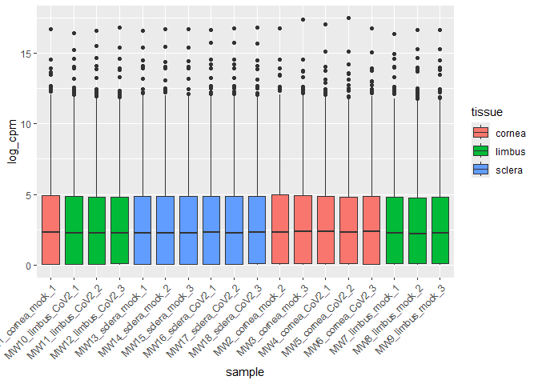
Box plot
one discrete variable + one continuous variable
ggplot(expr, aes(x = sample, y = log_cpm, fill = tissue)) + geom_boxplot() + theme(axis.text.x = element_text(angle = 45, hjust = 1))
Research Question:
How does the distribution of gene expression differ between samples?

Slide 12
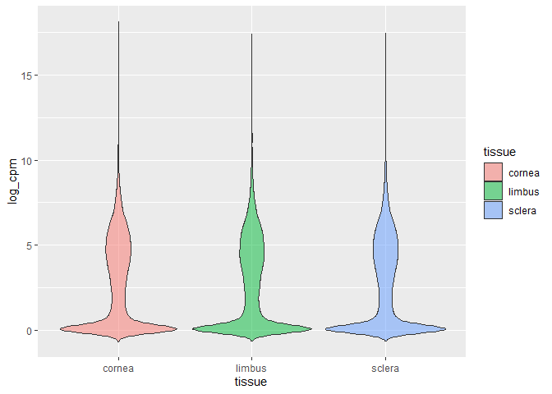
Violin plot
A combination of a box plot and a density plot
ggplot(expr, aes(x = tissue, y = log_cpm, fill = tissue)) + geom_violin(trim = FALSE, alpha = 0.5)
Research Question:
How does the distribution and variability of gene expression differ across tissues?

Slide 13
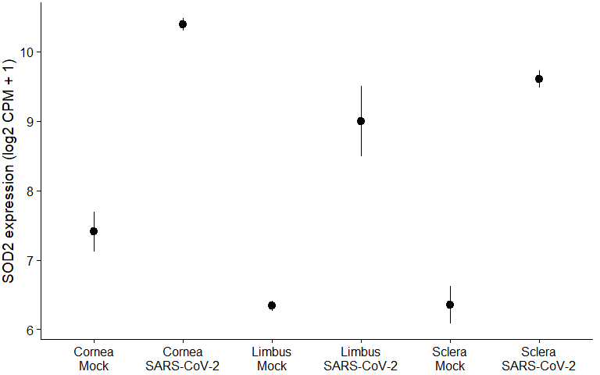
What questions do you have about this plot?
Notes:
What do the error bars represent? How many samples are behind each point? Could one unusual sample be driving a mean?

Slide 14
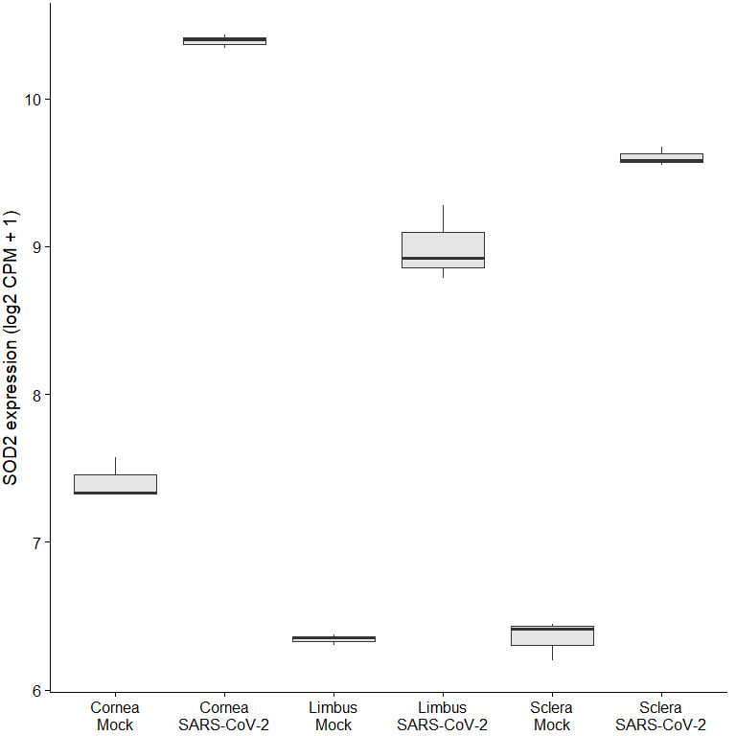
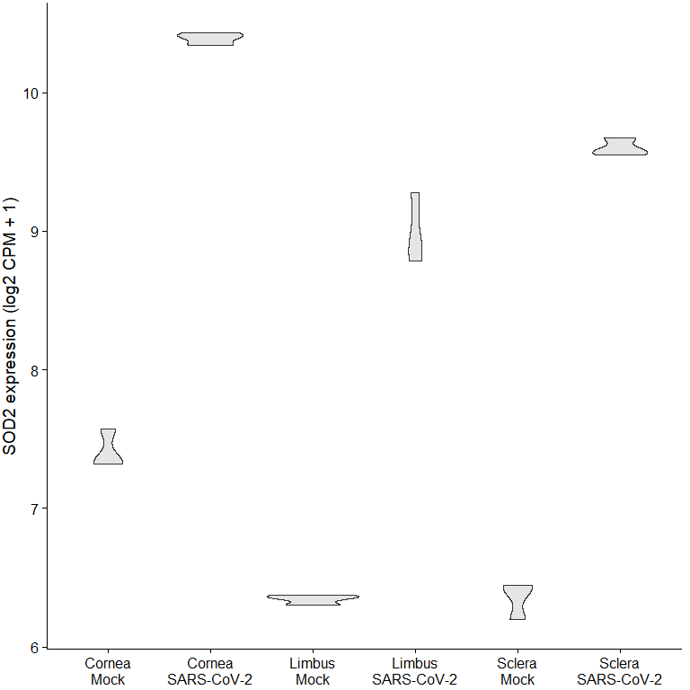
Next step: box/violin plot to show the distribution
What is the problem of the violin or box plot?
Notes:
These look more informative than the error bars but each one summarizes only **3 values**. A boxplot of 3 values is just the minimum, median, and maximum drawn as a box. The violin's smooth shape is invented by smoothing rather than shown by the data. Neither tells a viewer that n = 3.

Slide 15
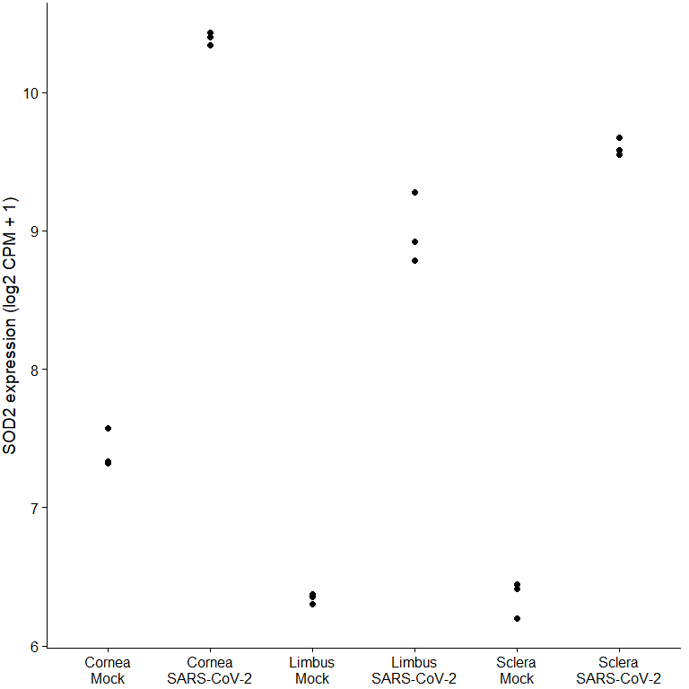
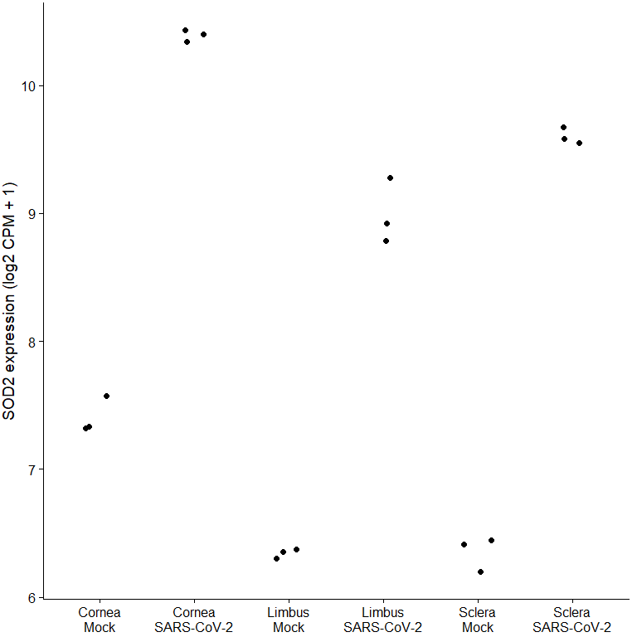
Show raw data points

Slide 16
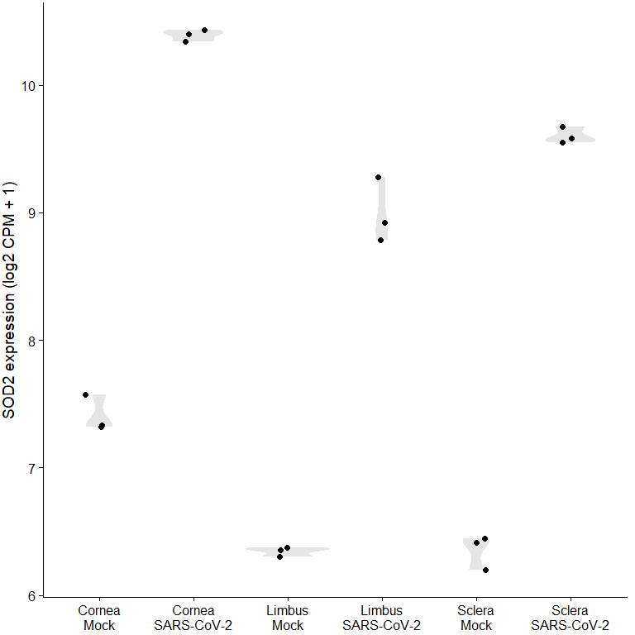
Combined…?
Notes:
With only 3 points per group, the violin plot is shapes that aren't necessarily reflecting the data. With small sample sizes, using a technique that shows the raw points is the best. Let's try something else.

Slide 17
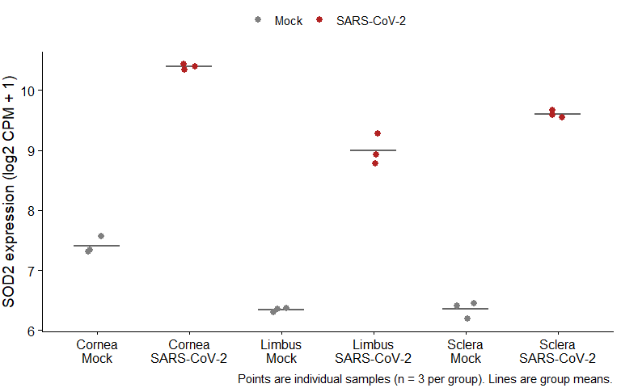
Before and after 💅🏽

Slide 18
Data Transformation and Advanced Customization

Slide 19
Data Transformation
 | Why? | Functions
Data reshaping | Useful for faceting or grouping variables | tidyr::pivot_longer() tidyr::pivot_wider()
Filtering rows and select columns | To focus on relevant data for a clearer visualization. To remove noise or unnecessary categories. | dplyr::filter() dplyr::select()
Aggregation and summarization | Transforming raw data into summarized statistics for better visualization. | dplyr::group_by() dplyr::summarize()
Normalization and scaling | Adjusting numerical values to ensure fair comparisons. Log transformation Min-max scaling Z-score standardization | dplyr::mutate() scale_x_log10()
Binning (Discretization) | Dividing a continuous variable into discrete categories to visualize distributions more clearly (e.g., in histograms or heatmaps). | dplyr::mutate()

Slide 20
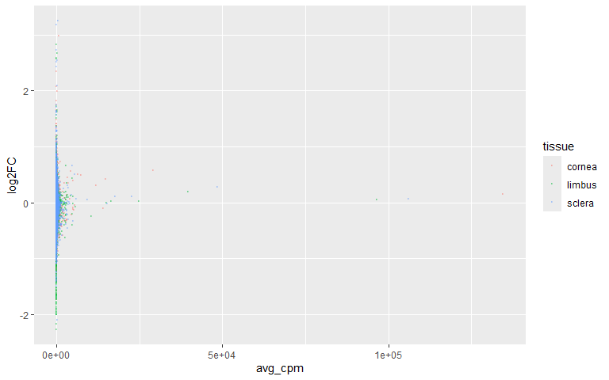
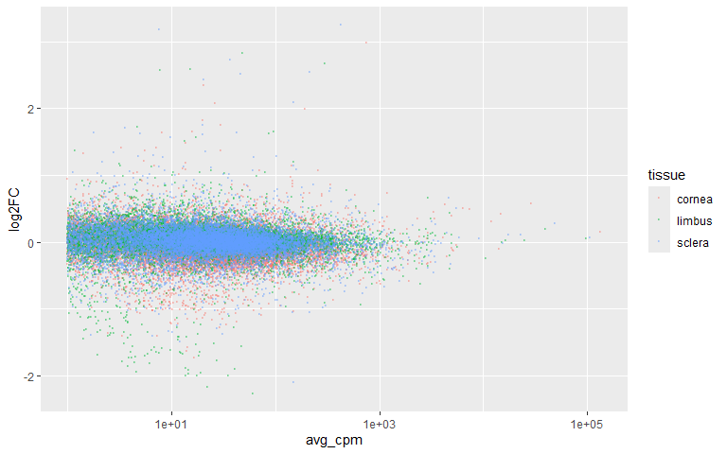
Data Transformation – log transformation
Research Question: How does a gene’s average expression level relate to how much it changes after SARS-CoV-2 infection, across different tissues?
+ scale_x_log10()

Slide 21
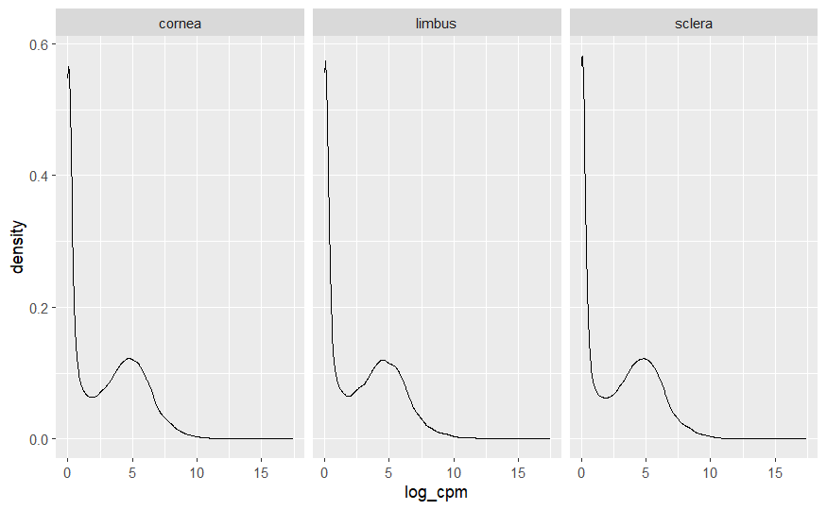
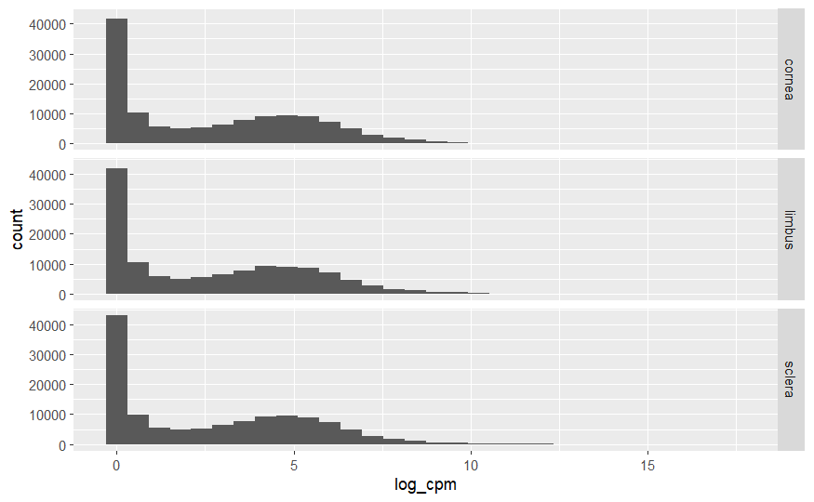
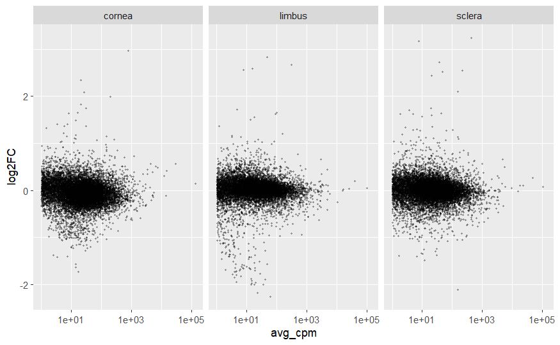
Data faceting
+ facet_grid(. ~ tissue)
+ facet_grid(tissue ~ .)
Facet_grid()
create a grid of graphs, by rows and columns
+ facet_wrap(~tissue)
Choose grid:
Compare categorical variables systematically
The number of facet levels is not too large
Choose wrap:
Flexible and space-efficient
Facet_wrap()
create small multiples by “wrapping” a series of plots

Slide 22
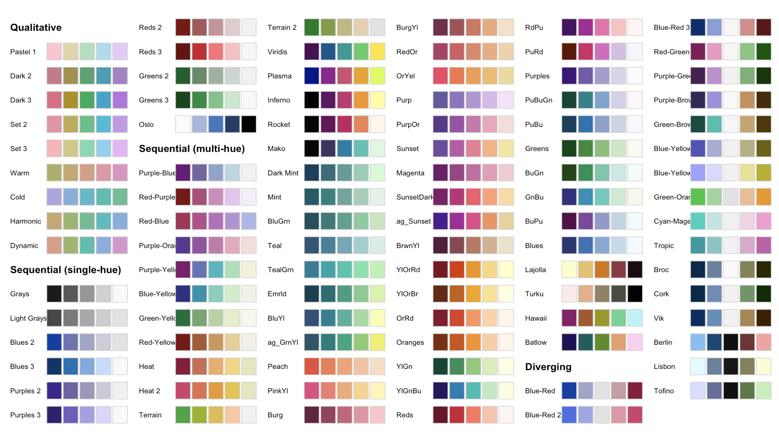
Aesthetic customizations – color palettes
colorspace
Qualitative: categorical variables
qualitative_hcl()
Sequential: ordered/continuous numerical variables
sequential_hcl()
Diverging: ordered/continuous numerical variables
diverging_hcl()
Don’t use bidirectional (diverging) color scales for unidirectional data!

Slide 23
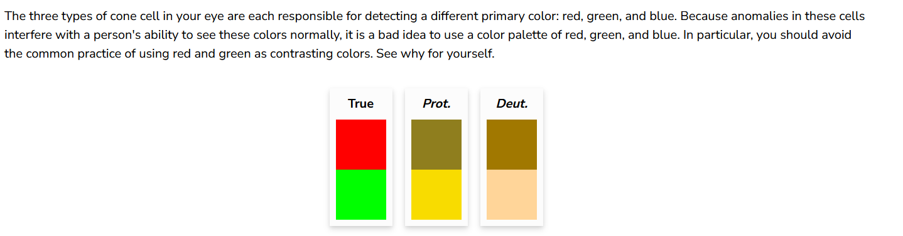
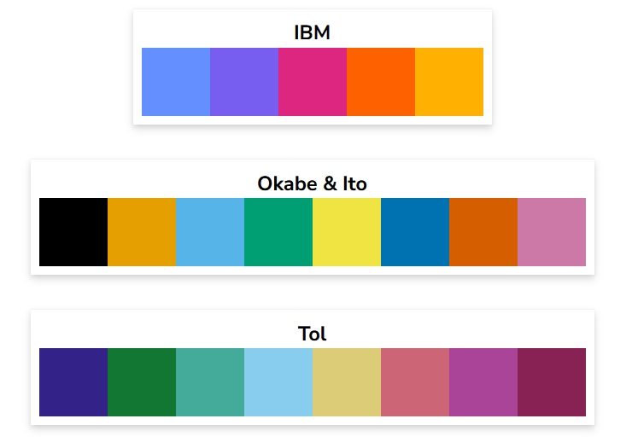
Colorblindness-friendly palettes
https://davidmathlogic.com/colorblind/#%23D81B60-%231E88E5-%23FFC107-%23004D40
https://cran.r-project.org/web/packages/khroma/vignettes/tol.html

Slide 24
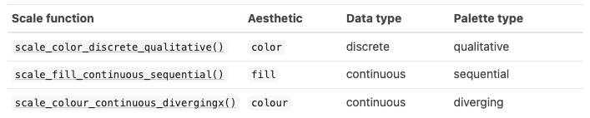
How to use colorspace in ggplot2
scale_<aesthetic>_<datatype>_<colorscale>()

Slide 25
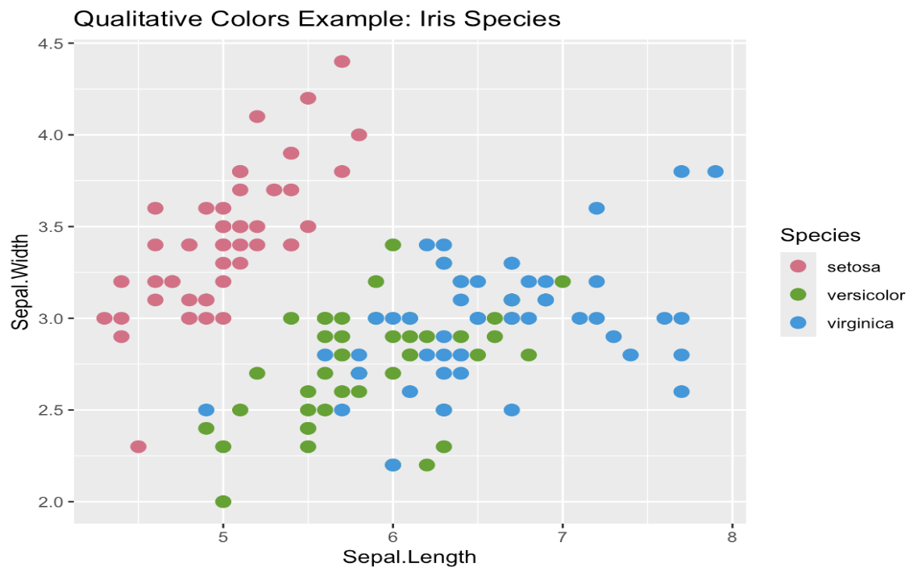
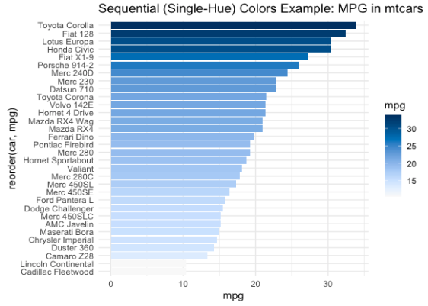
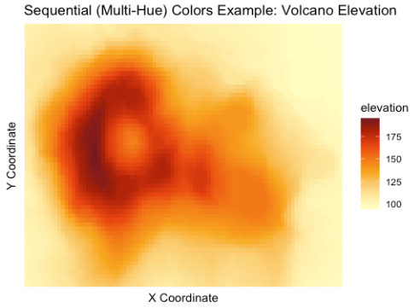
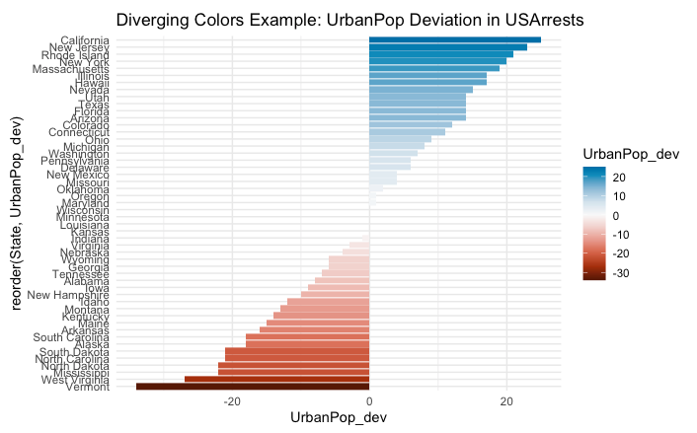
Colorspace examples

Slide 26
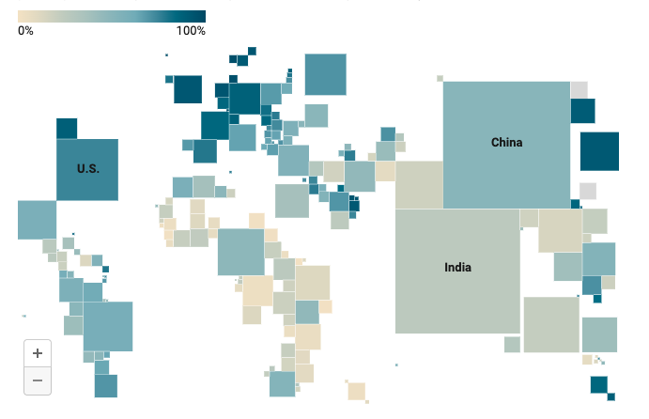
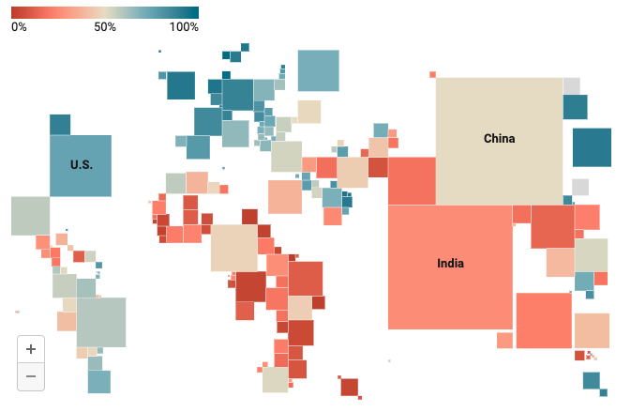
How to choose diverging and sequential color scales?
Use diverging scales IF…
…there’s a meaningful middle point
…you want to emphasize the extremes
…you want to let readers see more differences in the data
https://blog.datawrapper.de/diverging-vs-sequential-color-scales/

Slide 27
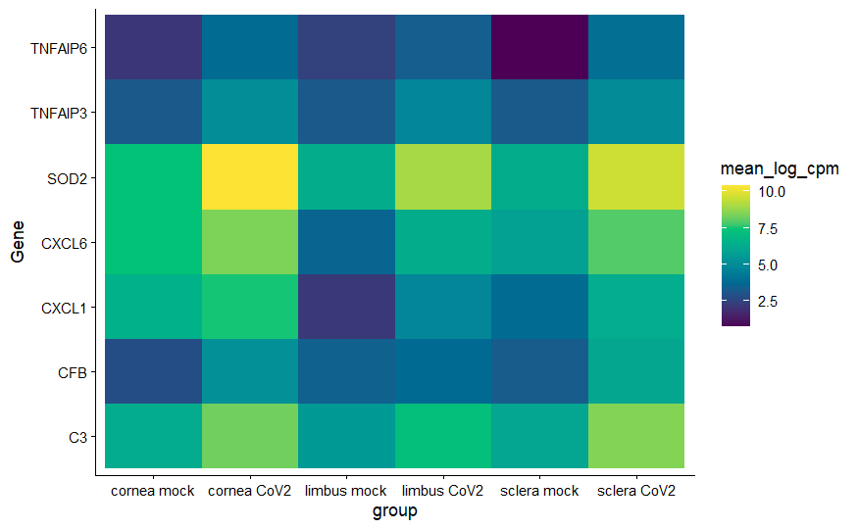
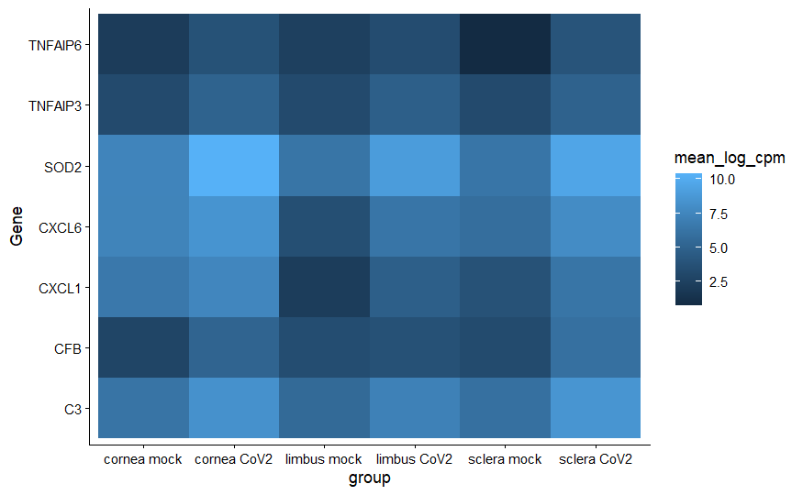
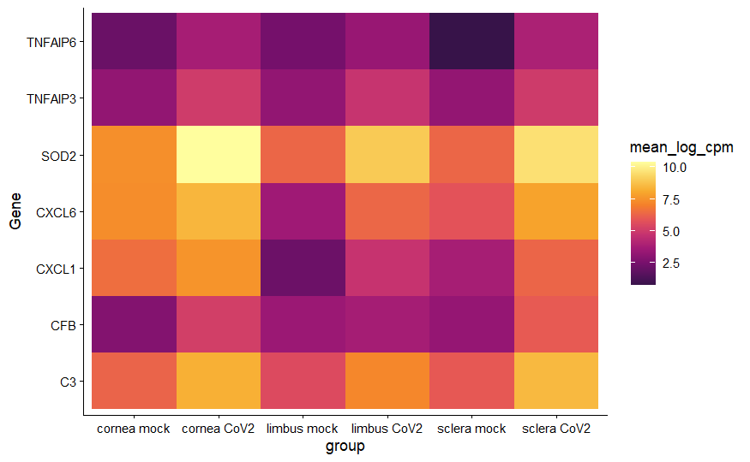
Select the appropriate color palettes for heatmaps
scale_fill_continuous_sequential(palette = "Viridis", rev = FALSE)
scale_fill_continuous_sequential(palette = ”Inferno", rev = FALSE)

Slide 28
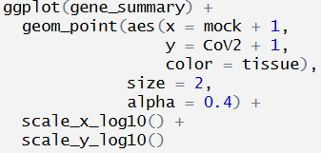
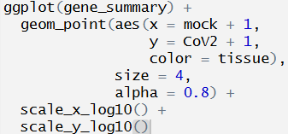
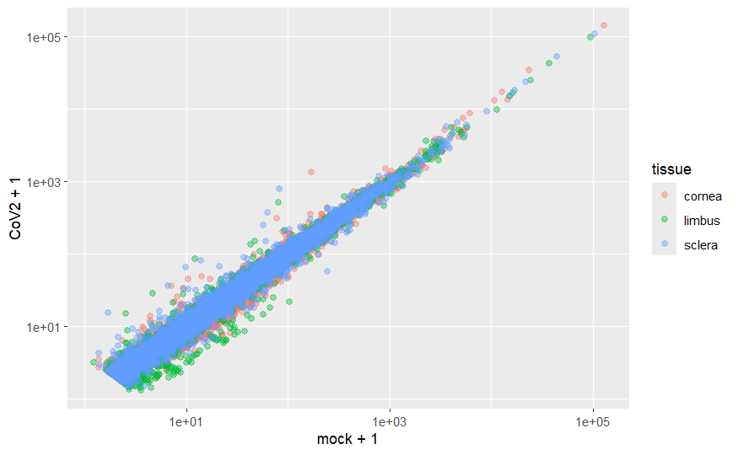
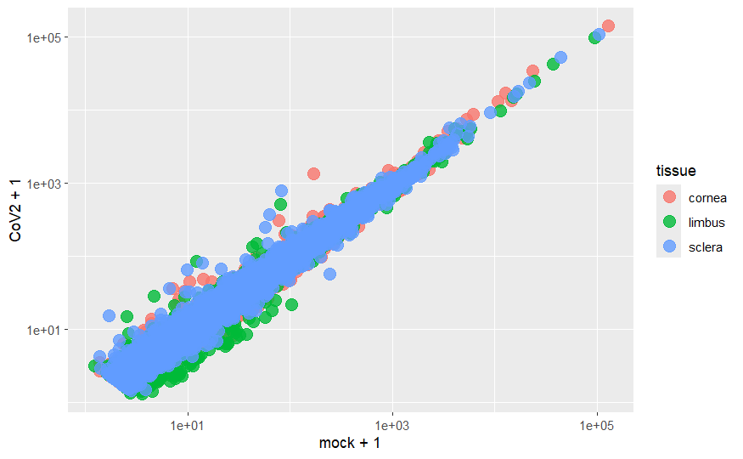
How to change size of points and transparency
Transparency:
alpha = number between 0 (completely transparent) and 1 (completely opaque)
Size of points: size

Slide 29
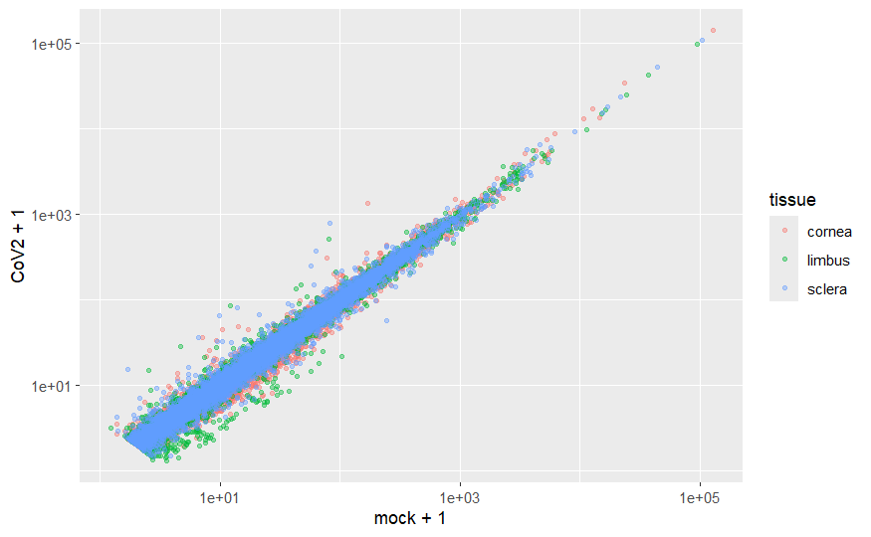
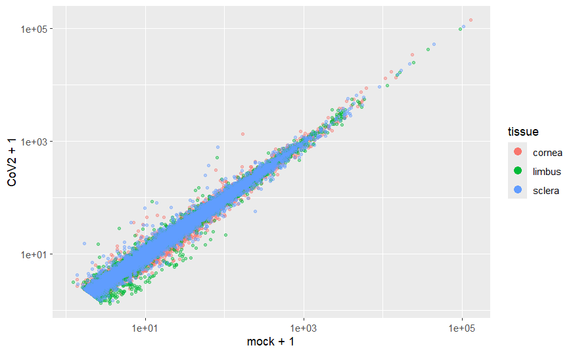
Adjust the appearance of the legend
+ guides(color = guide_legend(
override.aes = list(size = 3, alpha = 1))
)

Slide 30
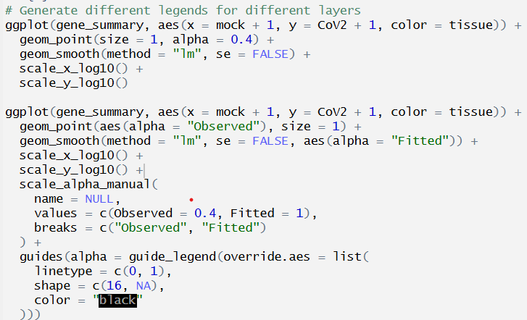
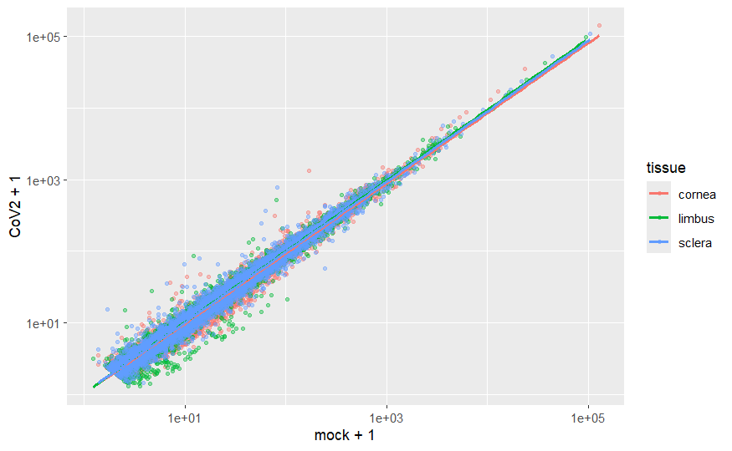
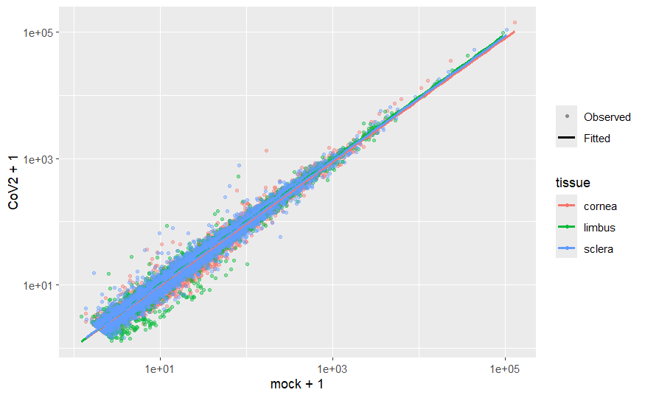
Generate different legends for different layers
How to add a legend to illustrate the original observations and the fitted line？

Slide 31
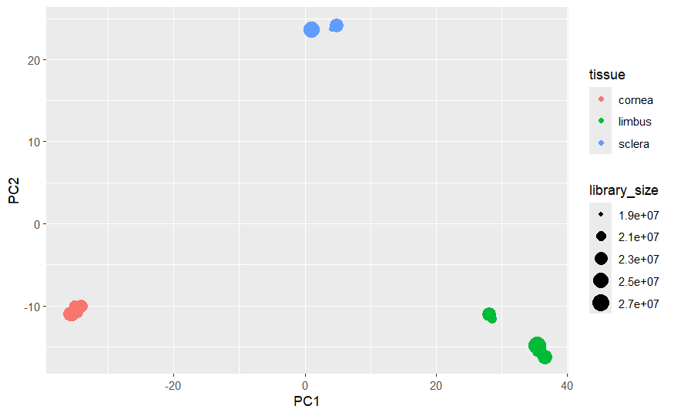
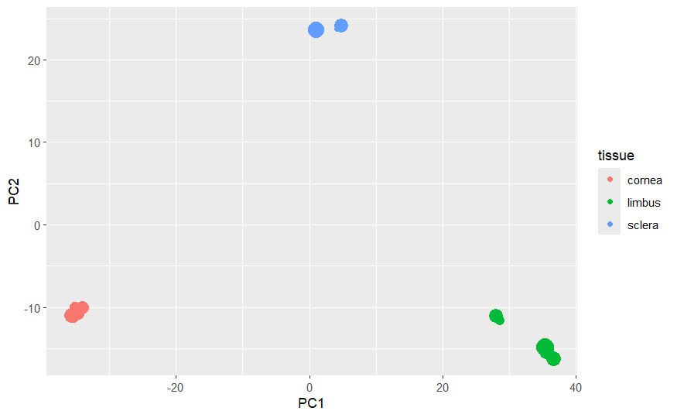
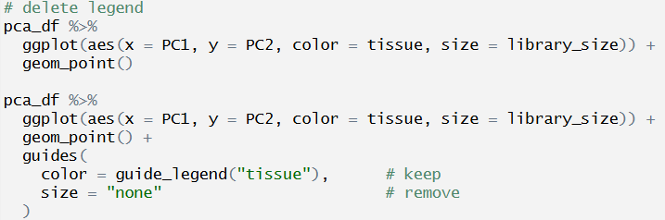
Delete the legend

Slide 32
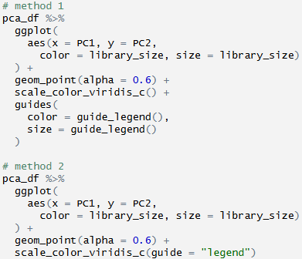


Merge the legend

Slide 33



Theme
df <- data.frame(x = 1:3, y = 1:3)
base <- ggplot(df, aes(x, y)) + geom_point()
base + theme_grey() + ggtitle("theme_grey()")
base + theme_bw() + ggtitle("theme_bw()")
base + theme_linedraw() + ggtitle("theme_linedraw()")
base + theme_light() + ggtitle("theme_light()")
base + theme_dark() + ggtitle("theme_dark()")
base + theme_minimal() + ggtitle("theme_minimal()")
base + theme_classic() + ggtitle("theme_classic()")
base + theme_void() + ggtitle("theme_void()")

Slide 34

Exercise 1 (10 mins)
Improve the plot based on the following requirements
Improving the axes and legend labels
Adding a title for the plot
Tweaking the color scale to your favorite palette
The background should be white, not pale grey
Major gridlines should be a pale grey and minor gridlines should be removed
The plot title should be centered in 12pt bold text

Slide 35
Specialized Plots

Slide 36

Heatmap
Base R: heatmap() Function
ggplot2 with geom_tile()
pheatmap for Annotated Heatmaps
Correlation analysis
Feature importance in Machine Learning
Geospatial data
Gene expression data in biology
Resource utilization
Data quality checks
Comparing performance metrics
Cluster analysis
Useful materials: https://r-graph-gallery.com/215-the-heatmap-function.html

Slide 37

Kaplan-Meier curve
Survival analysis
Estimate survival probability over time
“ggsurvplot()” from the survminer library is a useful function to generate KM curves using ggplot2

Slide 38

Manhattan plot
Used primarily in genome-wide association studies (GWAS) to visualize p-values across genomic positions.
Useful materials: https://r-graph-gallery.com/101_Manhattan_plot.html

Slide 39


2D density plot
A 2D density plot is a useful visualization to understand the distribution of data points over two continuous variables if you have a huge number of points.
geom_bin2d()
Useful materials: https://r-graph-gallery.com/2d-density-plot-with-ggplot2.html

Slide 40
Interactive Plots

Slide 41

What can you observe from this plot?
Do you have any questions about this plot?

Slide 42


Check the data
Any variables that could be used to further explain this plot?
Species/ Island?
What if we are still interested in individual info?

Slide 43

Try ggplotly!
What if we are interested in which island the penguin lives or any other information?

Slide 44


Customize tooltip

Slide 45


More advanced customization
Use bold text to make the tooltip more readable
Add a title to the tooltip
Change the background color of the tooltip to white
Change the font color of the tooltip to black

Slide 46

Animate your figure
Try gganimate!
https://gganimate.com/

Slide 47
R Shiny Dashboard
Shiny is an R package used to build interactive web applications directly from R
Common use cases: data visualization, dashboards, interactive reports, and real-time data processing.
Structure: UI (User Interface) + server (backend logic)
UI design: fluidPage(), sidebarLayout(), ……
Shiny is reactive, which means that inputs trigger changes in the outputs

Slide 48
Let’s first see an example of R shiny dashboard to analyze Omics Data - GraphBio
http://www.graphbio1.com/en/

Slide 49


Skeleton of R Shiny
User interface (UI)
[define visual elements]
+
Server
[handle the reactive behavior and interactions]

Slide 50



Layout options: Layout/Panel
SidebarLayout
TabsetPanel

Slide 51

Placeholders
Define a placeholder for plots, tables, and text in the user interface and server side.
Plot
Table
Text

Slide 52

Control Widgets
Allow users to interact with the app
Text box
Numeric input
Slider
Range selector
Radio button
Dropdown menu (single selection/multiple selections)
Checkbox
……
More widgets: https://shiny.posit.co/r/gallery/

Slide 53

Let’s work on a simple R shiny demo!

Slide 54



How to arrange shiny in multiple pages
Use dashboardPage() from shinydashboard package in UI! Another choice: navbarPage()
Check “3_ShinyDemo.R” to see how to combine “1_ShinyDemo.R” and “2_ShinyDemo.R” into one Shiny app.

Slide 55
Exercise 2 (15 mins)
Please select one of the example plots and use ggplotly to make it interactive. If you have time, try to create your own R shiny dashboard!

Slide 56

Friends don’t let friends make bad graphs
Don’t make violin plots for small sample sizes
Don’t make heatmap without checking outliers
Don’t use red/green and rainbow color scales
……
https://github.com/cxli233/FriendsDontLetFriends

Slide 57
Useful resources
ggplot2:
  Elegant Graphics for Data Analysis (3e) https://ggplot2-book.org/
  https://ggplot2.tidyverse.org/reference/
  More about data visualization in R (including code, very useful!)
    https://r-graph-gallery.com/
Fundamentals of Data Visualization:
  https://clauswilke.com/dataviz/
  Friends don’t let friends make bad graphs:
  https://github.com/cxli233/FriendsDontLetFriends
R shiny:
  https://shiny.posit.co/r/gallery/
  https://shiny.posit.co/r/getstarted/shiny-basics/lesson1/
  https://bookdown.org/weicheng/shinyTutorial/
  https://www.appsilon.com/post/r-shiny-in-life-sciences-examples

Slide 58

Thank you for attending!
Let us know what you think!

